Slide 1
COMMON LISP
NAMAN ANAND

Slide 2
WHY THIS LANGUAGE?
It is particularly suitable for Artificial Intelligence programs, as it processes symbolic information effectively.
Programs written in Common LISP do not depend on machine-specific characteristics, such as word length etc.
It uses iterative design methodology, and easy extensibility.
It allows updating the programs dynamically.
It provides high level debugging.
It provides advanced object-oriented programming.

Slide 3
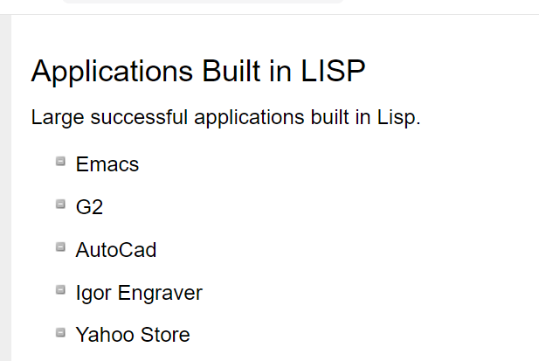
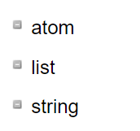
LISP
LISP expressions =>symbolic expressions or s-expressions.
The s-expressions are composed of three valid objects, atoms, lists and strings.
INTERPRETER => FOLLOWS REPL
READ EVALUATE PRINT LOOP
LISP uses prefix notation.
Three blocks :

Slide 4
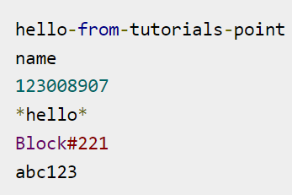
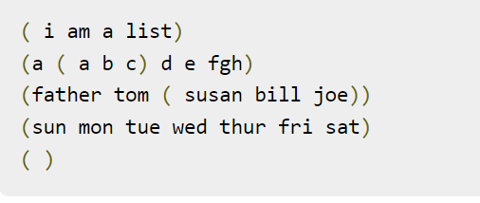
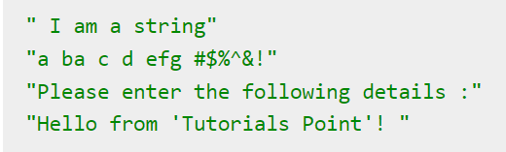
Building Blocks :
An atom is a number or string of contiguous characters. It includes numbers and special characters.
A list is a sequence of atoms and/or other lists enclosed in parentheses.
A string is a group of characters enclosed in double quotation marks

Slide 5
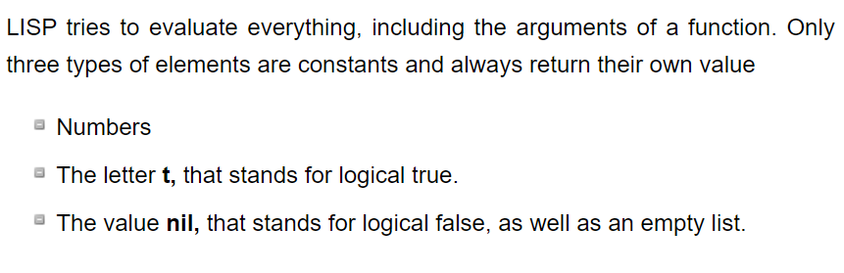
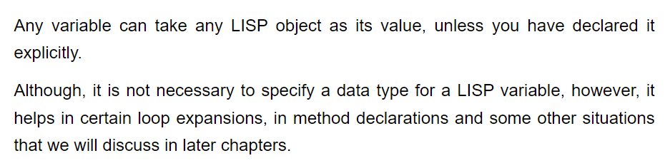
Lisp Imp Points :

Slide 6
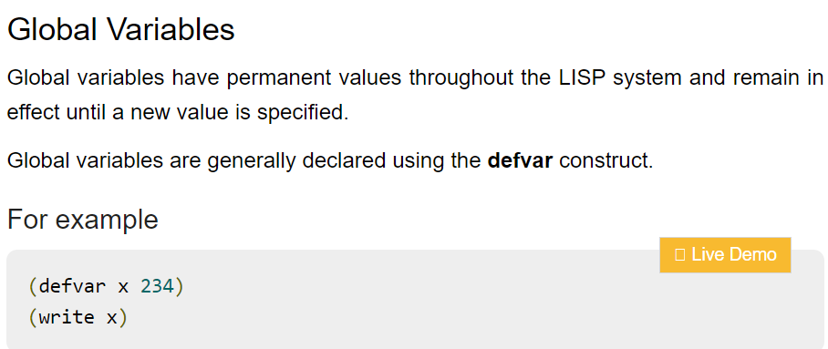
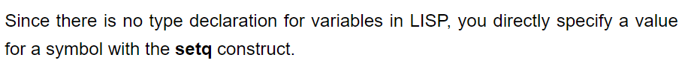
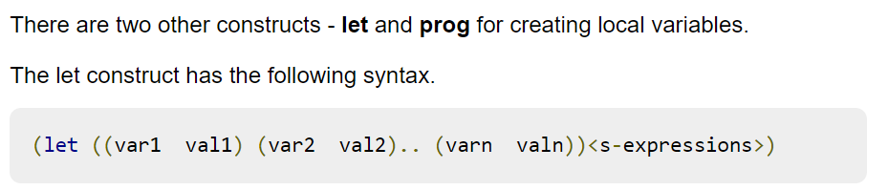
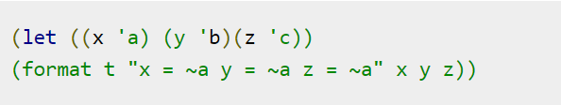
Variables In Lisp :

Slide 7
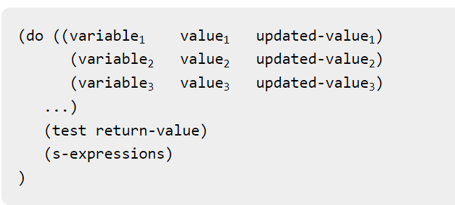
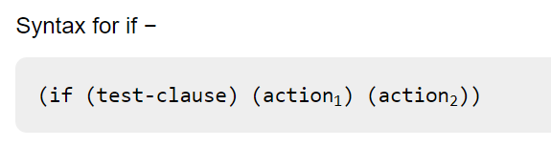
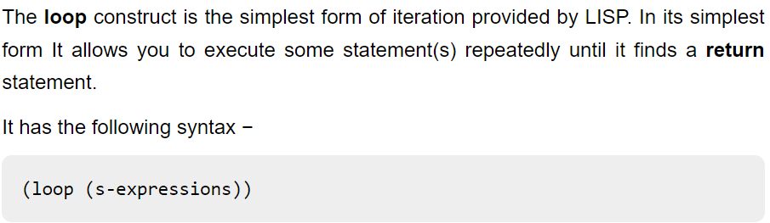
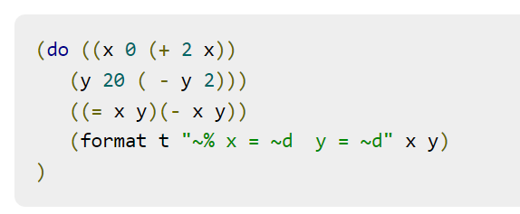
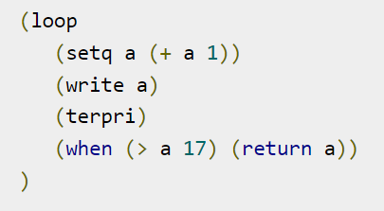

Slide 8
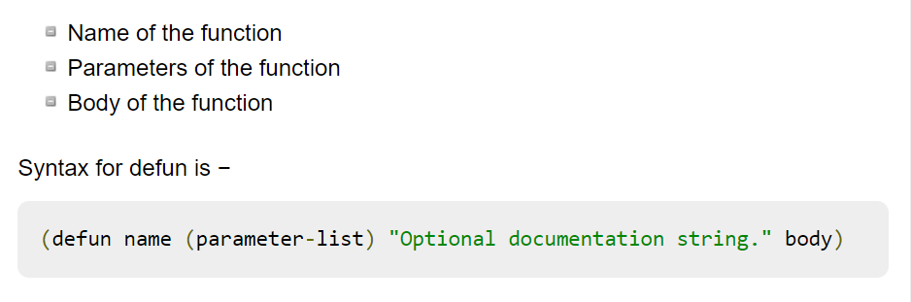
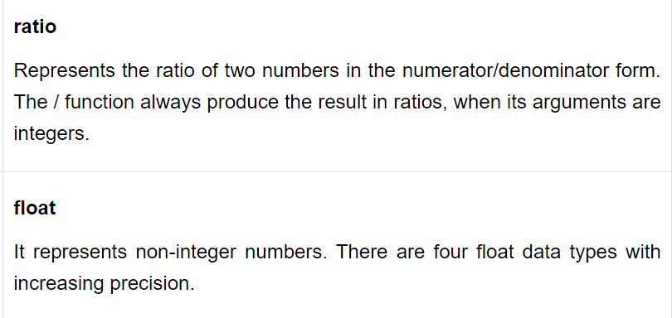
Func in lisp :

Slide 9
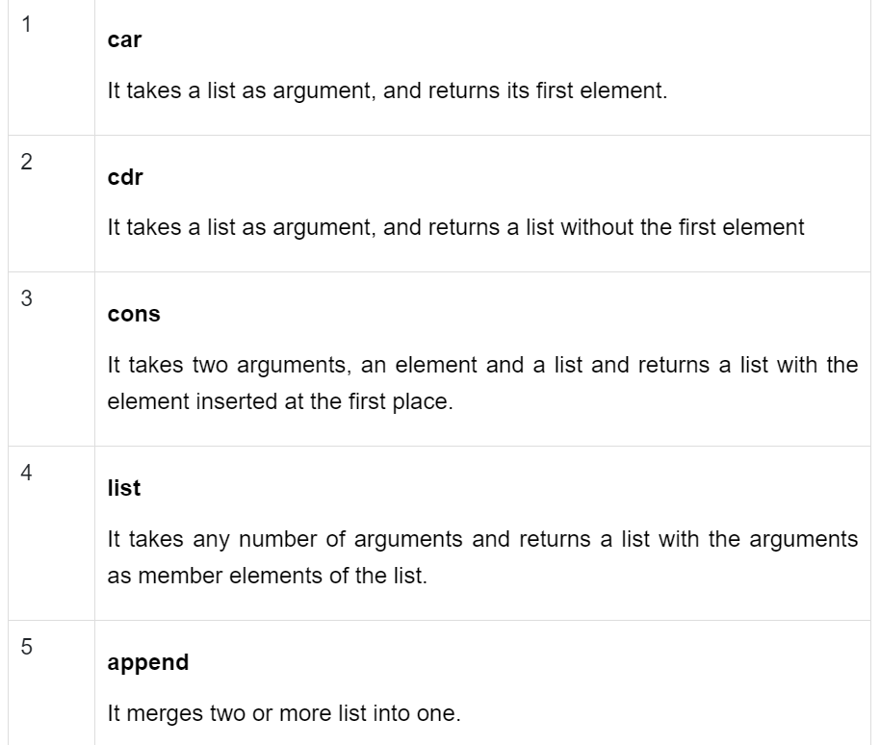
List

Slide 10
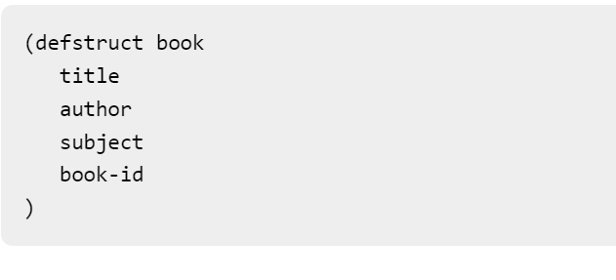
Structure :

